Slide 1


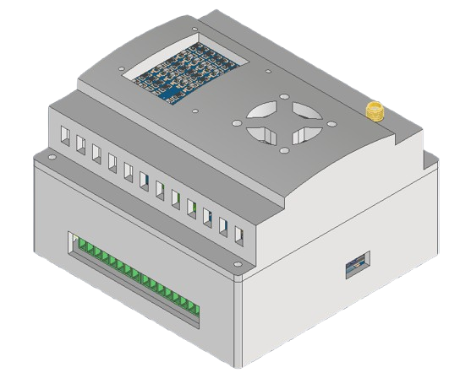

IOT NODE
SMART INDUSTRIAL CONNECTIVITY
SIMPLE, COMPACT, CONNECTED
By KRSBI-H UNY

Slide 2
DESAIN PRODUK

Slide 3
DIMENSI PRODUK
7,7 CM
10,5 CM
10,3 CM

Slide 4
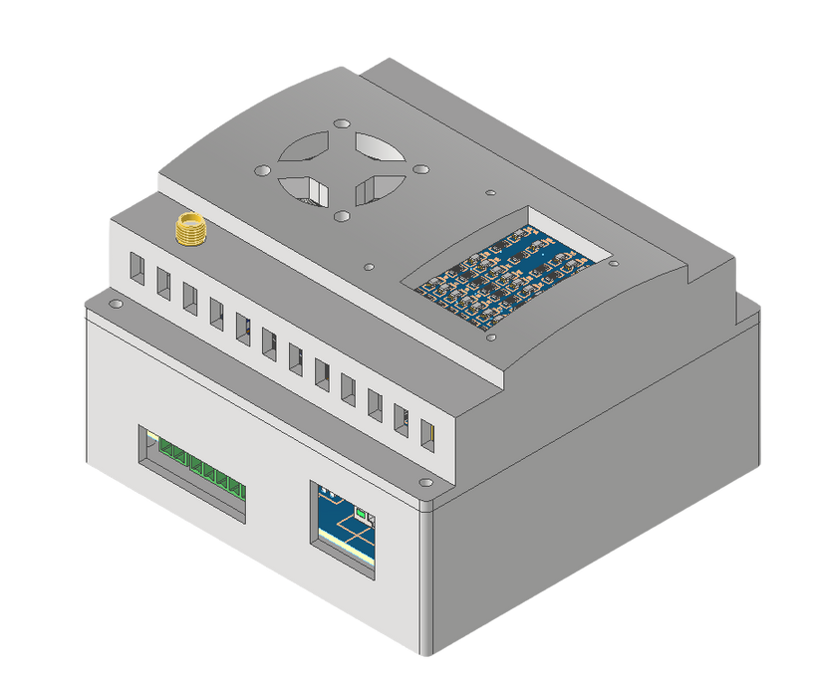
LAYOUT
Exhaust
Fan
Interface
Antena Eksternal
pin Power
4 pin
output
16 pin input
Uploader
Port
Ethernet

Slide 5
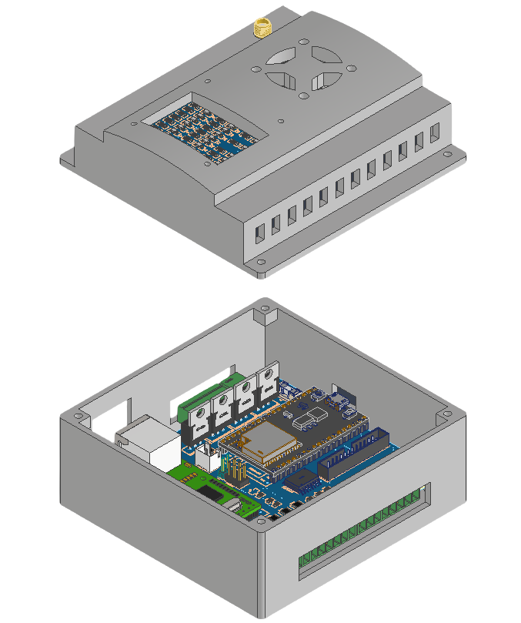
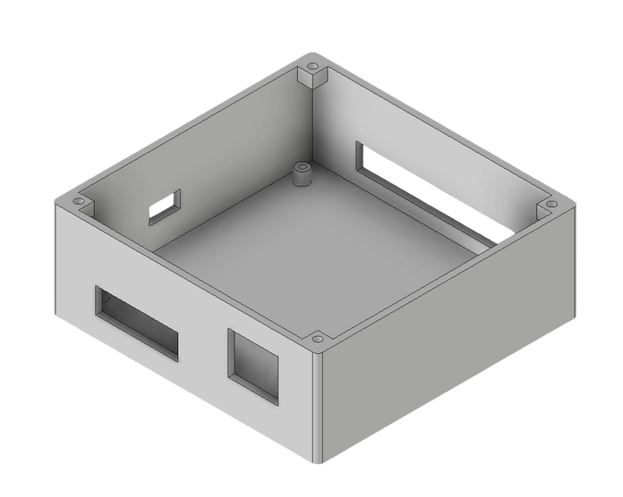
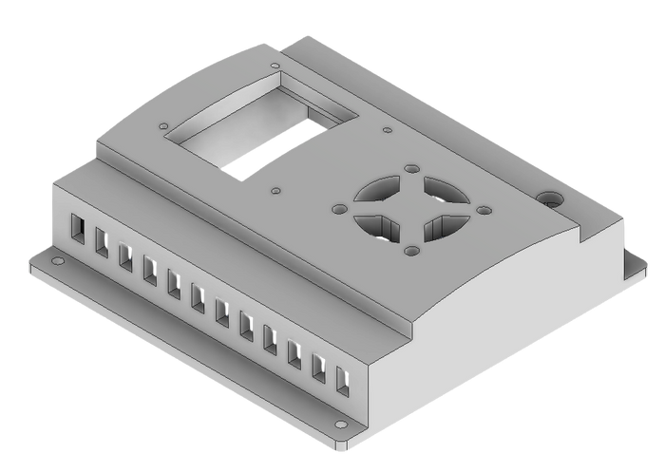
Box
Assembly
Tutup

Slide 6
SKEMATIK PRODUK

Slide 7
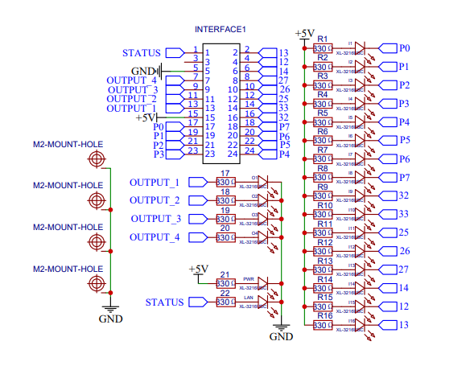

Slide 8
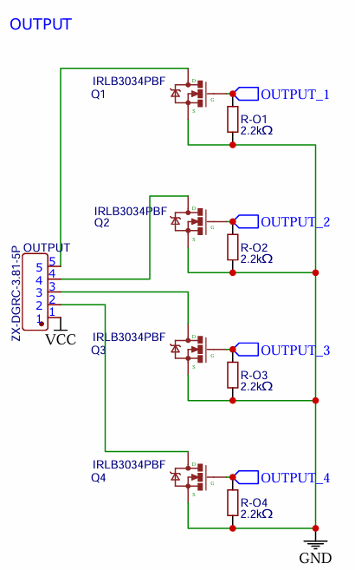
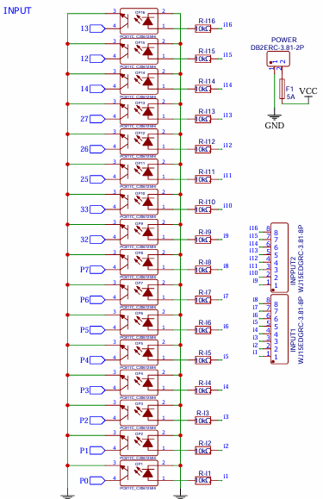

Slide 9
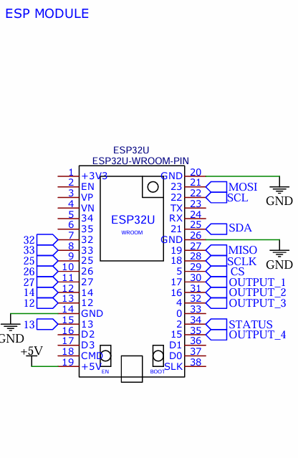
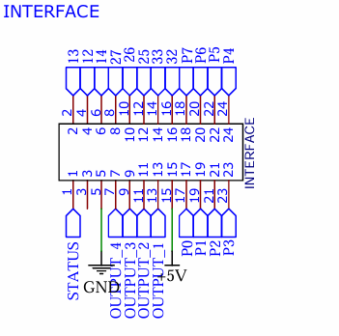

Slide 10
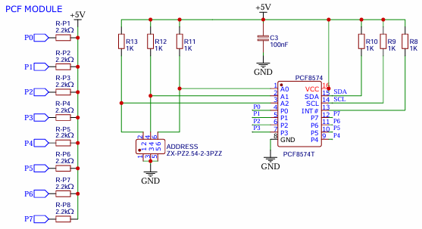

Slide 11
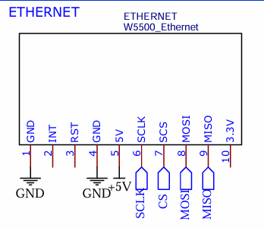
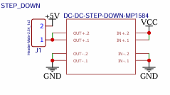
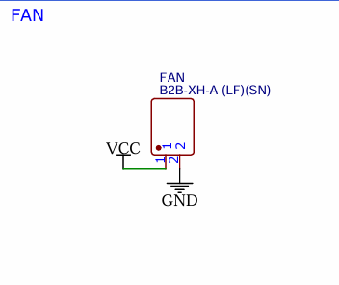
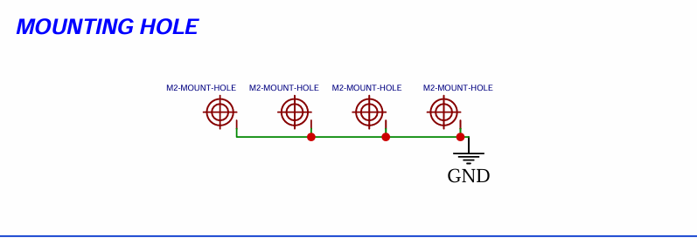

Slide 12
FITUR-FITUR PRODUK

Slide 13




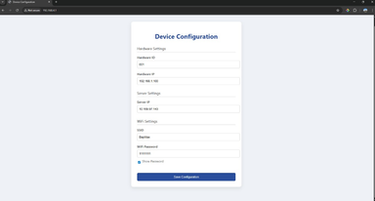
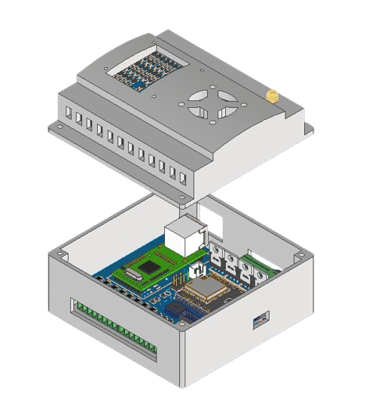
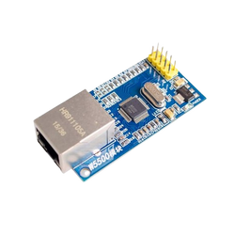
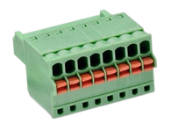
OTA Firmware Update
Buffer Internal for lost connection
WebSocket
MQTT
HTTP
Setting config : Ws, Serial, Web
Web UI Konfigurasi
16 Pin Input 0-24vDc
Ethernet
4 Pin Output 0-24vDc

Slide 14
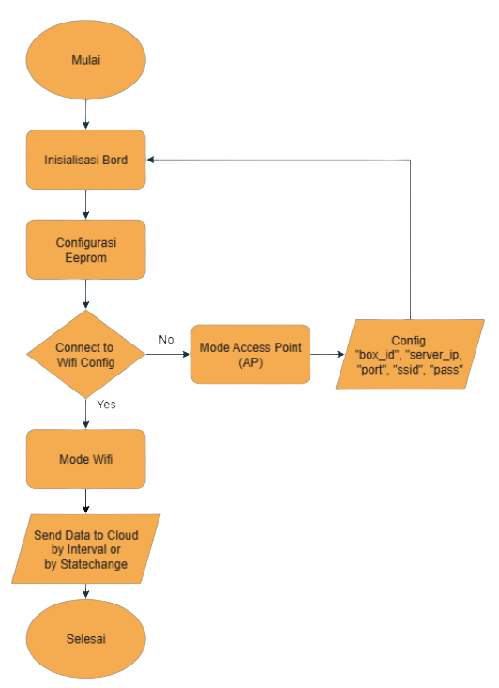
Flowchart
Penggunaan

Slide 15
THANK YOU

